Slide 1

WEEKLY #4 PRESENTATION
Pre class DumbWays Batch-26

Slide 2
Presentation Point
01
HOF and Callback
Remake Todo App
02
Asynchronous
Remake Number generator

Slide 3
High Order Function (HOF) & Callback

Slide 4
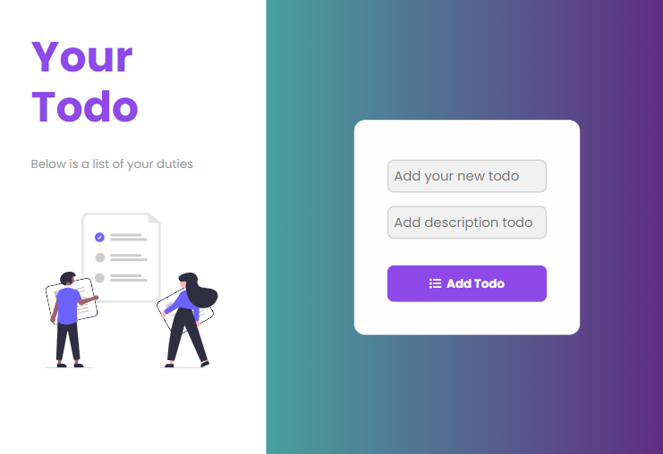
Welcome!!
Insert the title of your subtitle Here
This PowerPoint Template has clean and neutral design that can be adapted to any content and meets various market segments.

Slide 5
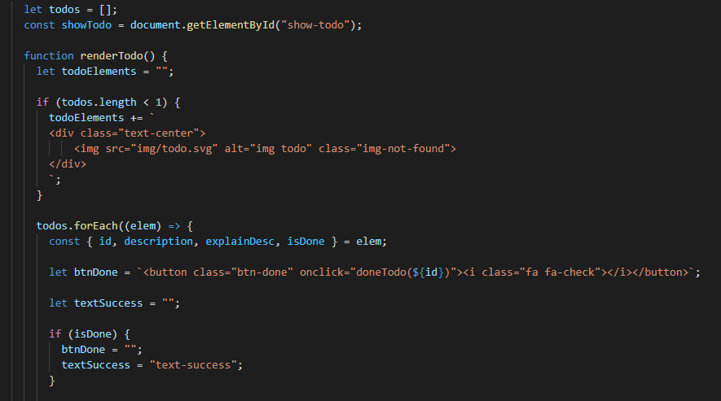

Slide 6
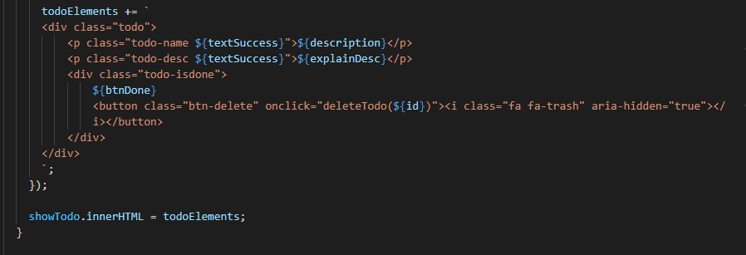

Slide 7
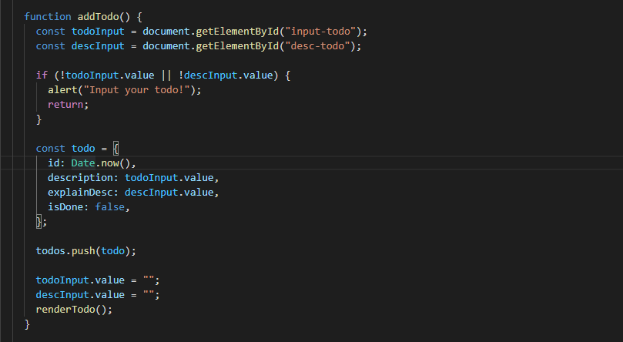

Slide 8
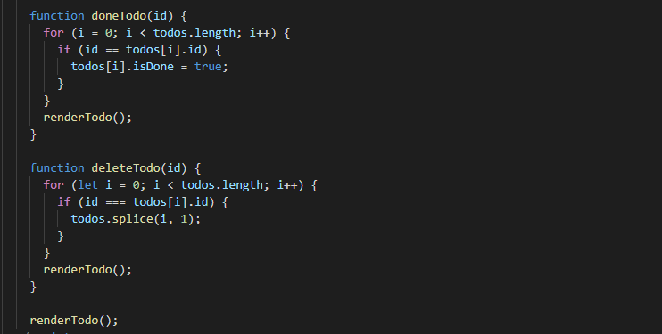

Slide 9
Asynchronous Programming

Slide 10
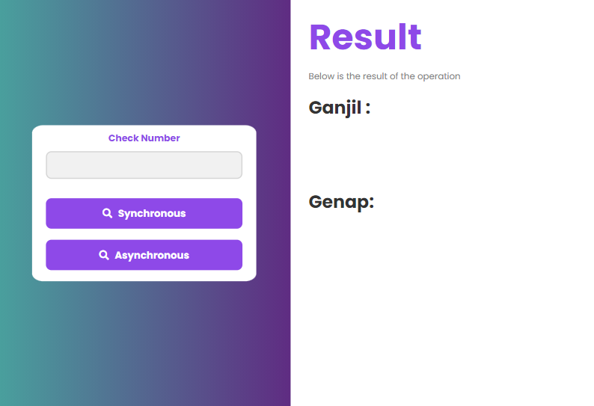
Welcome!!
Insert the title of your subtitle Here
This PowerPoint Template has clean and neutral design that can be adapted to any content and meets various market segments.

Slide 11
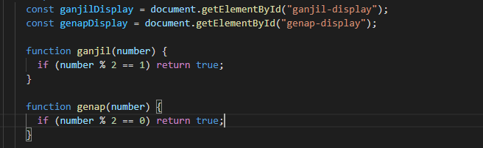

Slide 12
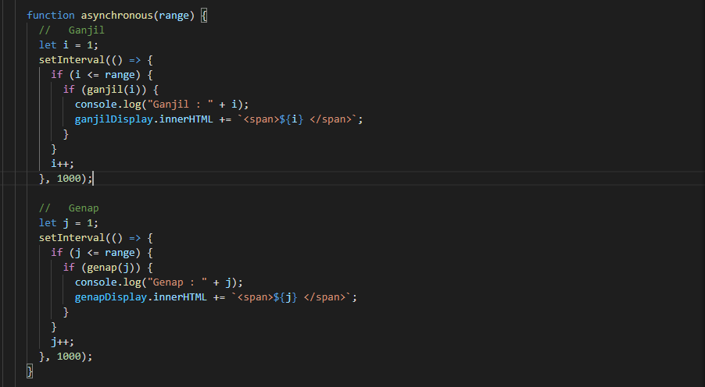

Slide 13
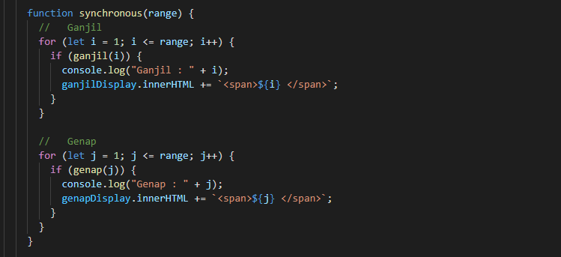

Slide 14
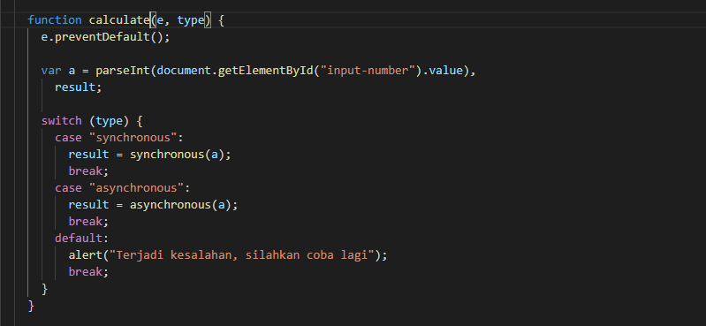

Slide 15
Thank you
Have a nice day ☺

